Slide 1
AHLA Day
Get Started – Get Connected – Get Involved

Slide 2
HEALTH LAW COMMUNITY
Hospitals and Hospital Systems
AHLA members are part of a diverse and inclusive
community of health law professionals who represent the entire spectrum of the health care industry.
Other Entities on Bus., Corp., Reg.
Matters
Physicians
AHLA
Managed Care Organizations
Home Health Agencies
Insurers
Long Term Care Facilities

Slide 3
www.americanhealthlaw.org

Slide 4
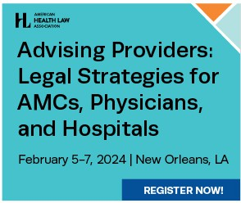
Education
Get Started
Offerings that suit all types of learning styles
Live Webinars – Virtual events delving into issues affecting you and your clients. Discount for Full/Enhanced, FREE for Premium
In-Person and Virtual Conferences – Learn from experts in the field and apply that knowledge immediately. Discounts vary according to member level. Member Discounts
On-Demand – Webinars for CLE self-study; ePrograms for session level content from AHLA in-person conferences. Member Discounts

Slide 5
Connect, Learn, Advance Virtually
On-Demand Education Live Education Speaking of Health Law
Policy & Administration Resource
AHLA
Webinars and Virtual Conferences
E-Programs and Webinars
Premier Nonpartisan Newsletter
Podcasts
Take a deep dive into a variety of practice areas and subjects, at your convenience, and earn CLE and CPE. Recorded from live and in-person programs, each on-demand program features leading experts and covers a range of topics.
AHLA’s Speaking of Health Law podcasts offer thoughtful analysis and insightful commentary on the legal and policy issues affecting the American health care system. Subscribe to the Speaking of Health Law channel on your favorite platform.
Webinars and other virtual programs are delivered live and feature discussions on pressing issues across a variety of topics. On-demand recordings of webinars and conferences are also available so you can learn and earn CLE and CPE on your schedule.
AHLA members receive a weekly newsletter to help them stay current on complex policy shifts and administration actions. The newsletter includes curated news, quick takes, and related AHLA resources.

Slide 6
Connect, Learn, Advance Virtually
Educating and Connecting the Health Law Community
Annual In-Person Conferences
Fraud and Compliance Forum
Fundamentals of Health Law
The Institute on Medicare and Medicaid Payment Issues
Health Care Transactions
AHLA Annual Meeting
In-House Counsel Program
The AHLA In-House Counsel Program takes place prior to the Annual Meeting, in the same location, and focuses on practical methods to professionally
thrive amid the evolving challenges in-house counsel face.
Other Trainings
Tax Issues for Health Care Organizations
Advising Providers: Legal Strategies for AMCs, Physicians, and Hospitals
Long Term and Post-Acute Care Law and Compliance
Health Care Arbitration Training

Slide 7
Community
The AHLA community enables members to share and connect with other health law professionals while getting the support you need to succeed in an ever-changing industry.
Practice Groups Enables members to contribute their expertise, network, and receive additional resources.
Health Law Network Connect with members, leaders, opportunities and events.
Mentoring Program Work with a member who will serve as a trusted advisor and role model.
(Included for ALL Membership Levels)
7 | AHLA Member Benefits

Slide 8
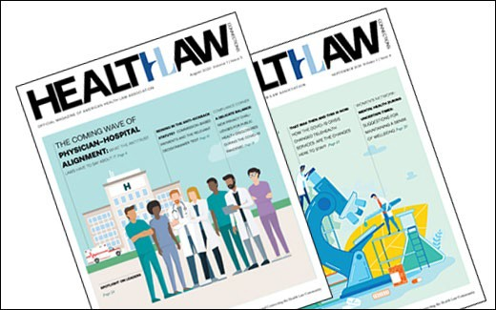
Member Publications
Health Law Daily and Health Law Weekly Customized daily and weekly email digests, providing summaries of current health law news.
Health Law Connections
Bi-monthly magazine featuring legal analysis written by members, association and member news and more.
Health Law Archive
Online searchable database containing over 30,000 documents and audio recordings (included for members at the Premium membership level).
8 | AHLA Member Benefits

Slide 9
Build Your Reference Shelf
Members are entitled to exclusive discounts on AHLA titles published in cooperation with LexisNexis. Our deepest dives, written by members of the health law community.
AHLA-LexisNexis Store
9

Slide 10
Practice Groups
Academic Medical Centers and Teaching Hospitals | Antitrust | Behavioral Health
Business Law and Governance | Fraud and Abuse | Health Care Liability and Litigation
Health Information and Technology | Hospitals and Health Systems | In-House Counsel
Labor and Employment | Life Sciences | Medical Staff, Credentialing, and Peer Review
Payers, Plans, and Managed Care | Physicians Organizations | Post-Acute and Long-Term Services
Regulation, Accreditation, and Payment | Tax & Finance
Belonging to one or more Practice Groups (PGs) gives members the ability to network with other health law professionals from across the country.
Full Level Enhanced Level Premium Level
PG
PGs
Unlimited
10 | AHLA Member Benefits

Slide 11
Engage with Leading Professionals
Practice Groups
Practice Group Programming
Practice Group Resources
The Health Law Network
17
Topic/ Settings- Based Groups
3,200
Published Articles
80+
Live Webinars
12K
Connections
AHLA's Practice Groups (PG) connect professionals who share similar work settings or focus areas. By joining a PG, you gain access to valuable tools and education, as well as a diverse network of professionals from around the country.
Practice Group leaders, volunteers, and staff produce distance learning events including live webinars. (An all-access pass to PG live webinars is available at the Premium membership level.)
Each Practice Group provides exclusive access to a Topical Library of resources and publications to support members in meeting the unique challenges of their discipline.
AHLA’s online community platform allows you to connect with a community of dedicated professionals who share your commitment to health law. As a member, complete your profile to engage with peers and industry leaders, ask questions, share resources, and build your network.
1 | AHLA Member Benefits

Slide 12
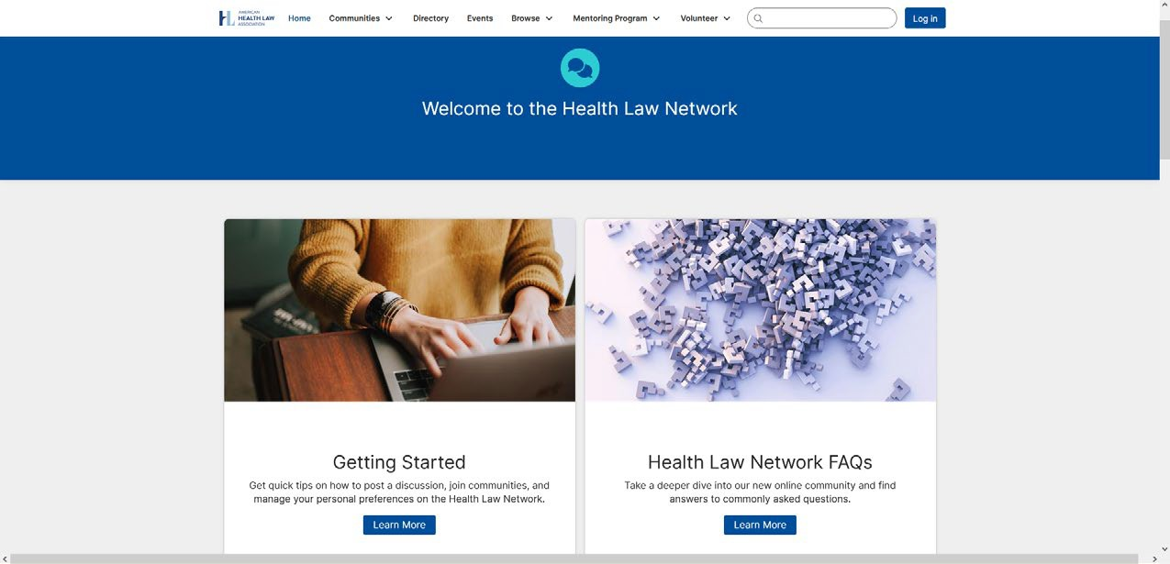
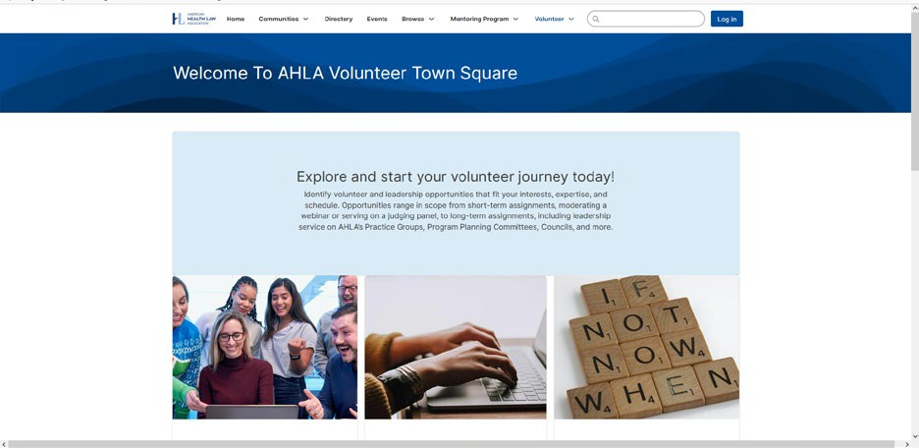
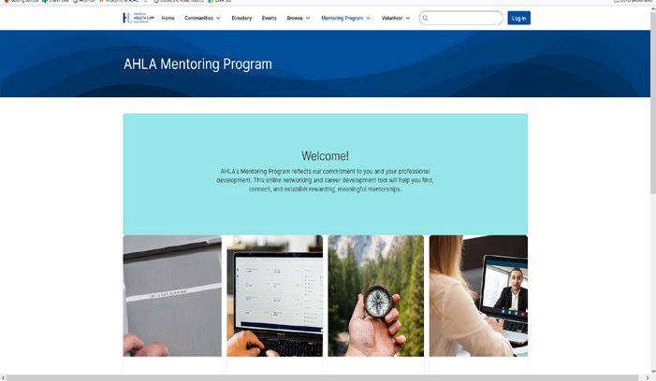
Health Law Network – Included in ALL Membership Levels
Members participate in online discussions on topics that interest them most
View upcoming events
Identify volunteer and leadership opportunities
Become a Mentee Match with a Mentor

Slide 13
Showcase Your Organization's Talent
The lifeblood of the Association starts with our dedicated volunteers. We need members to write, speak, record, and volunteer to become the next generation of leaders.
WRITE | SPEAK | LEAD
Contribute to Practice Group Content (e.g., briefings, bulletins, toolkits) Write a Feature Article for the Health Law Connections magazine Post in Health Law Topical Community | Moderate an event/session Serve as a Panelist Speak at a Conference Present on a podcast Share at networking event | Apply for AHLA Leadership Become a Mentor Serve as an AHLA Ambassador Support AHLA’s Philanthropic Activities Recruit New Members

Slide 14
© 2025 is published by the American Health Law Association. All rights reserved. No part of this publication may be reproduced in any form except by prior written permission from the publisher. Printed in the United States of America.
Any views or advice offered in this publication are those of its authors and should not be construed as the position of the American Health Law Association.
“This publication is designed to provide accurate and authoritative information in regard to the subject matter covered. It is provided with the understanding that the publisher is not engaged in rendering legal or other professional services. If legal advice or other expert assistance is required, the services of a competent professional person should be sought” —from a declaration of the American Bar Association.
14 | AHLA Member Benefits

